Slide 1
Methods & Exception Handling
BACS2023 Object-Oriented Programming
Chapter 2

Slide 2
Learning Outcomes
At the end of this chapter, you should be able to
Define methods, invoke methods and pass arguments to methods.
Use method overloading in programs.
Apply basic exception handling.

Slide 3
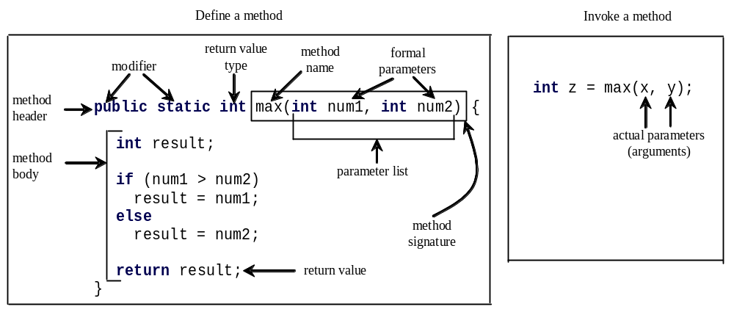
1. Methods
In Java, a function is known as a method.

Slide 4
Method Signature
Method signature is the combination of the method name and the parameter list.

Slide 5
Formal Parameters
The variables defined in the method header are known as formal parameters.

Slide 6
Actual Parameters
When a method is invoked, you pass a value to the parameter. This value is referred to as actual parameter or argument.

Slide 7
Passing Parameters
The arguments (in the method call statement) must match the formal parameters (in the method definition) in order, number and compatibility type.
public static void nPrintln(String message, int n) {
for (int i = 0; i < n; i++)
System.out.println(message);
}
What is the output from these method calls:
nPrintln(“Welcome to Java”, 5);
nPrintln(“Computer Science”, 15);

Slide 8
Pass by Value
In Java, the value of the argument is passed to the parameter.
The variable used as an argument is not affected regardless of the changes made to the parameters inside the method.

Slide 9
Pass by Value
public class ByValueTest {
public static void main(String[] args) {
int num = 1;
System.out.println(“Num : ” + num );
change(num1);
System.out.println(“Num : ” + num );
}
public static void change (int num) {
System.out.println("Before : ” + num);
num ++;
System.out.println("After : " + num);
}
}
Output:
Num : 1
Before : 1
After : 2
Num : 1

Slide 10
Return Value Type
A method may return a value. The return Value Type is the data type of the value the method returns.
If the method does not return a value, the return Value Type is the keyword void.

Slide 11
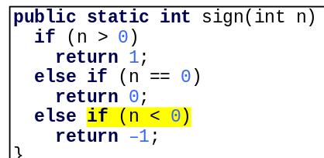
CAUTION
A return statement is required for a value-returning method.
The method shown below in (a) is logically correct, but it has a compilation error because the Java compiler thinks it possible that this method does not return any value.
How can we fix this problem?
Notes:
Delete if (n < 0) in (a), so that the compiler will see a return statement to be reached regardless of how the if statement is evaluated.

Slide 12
2. Modifiers
Modifiers are the reserved words that specify the properties of the data, methods and classes and how they can be used.
Examples of modifiers are public, private, protected, static, final and abstract.
A public datum, method or class can be accessed by other programs.
A private datum or method cannot be accessed by other programs.
[note : Modifiers are discussed in Chapter 4, “Objects and Classes.”]
Notes:
Final - method cannot be overridden by subclasses.

Slide 13
2. Modifiers
Default: When no access modifier is specified for a class , method or data member – It is said to be having the default access modifier by default.
  having default access modifier are accessible only within the same package.

Slide 14
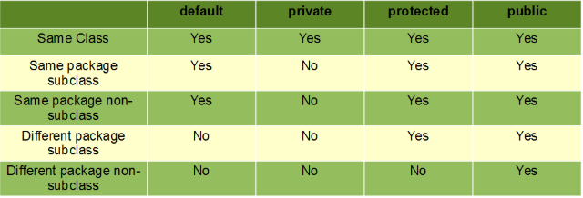

Slide 15
Static Keyword
Used a lot in java programming
Apply java static keyword with
  Variables
  Methods
  Nested class
  Block

Slide 16
Static Variable
Are shared by all the instances of the class.
May be accessed using the object name or the class name
The static variable can be used to refer the common property of all objects(that is not unique for each objects) e.g collage name of students, company name of employees etc.
Notes:
Consider these are 100 students in a college named "ABC", each student have their own unique roll number and name but the college remains the same among all the 100 students. The college field is declared as static so it can occupy memory only once.

Slide 17
Static methods
belongs to the class rather than the object of a class.
can be invoked without the need for creating an instance of a class.
can be accessed directly in static and non-static methods.
For example, the main() method that is the entry point of a java program itself is a static method.

Slide 18
3. Reuse Methods from Other Classes
public class TestMax {
public static void main(String[] args) {
int i = 5, j = 2;
int k = max(i, j);
System.out.println("The maximum between " + i + " and " + j + " is " + k);
}
/* Return the max between two numbers */
public static int max(int num1, int num2) {
int result;
if (num1 > num2)
result = num1;
else
result = num2;
return result;
}
}
The max method can be invoked from any class besides TestMax.
If you create a new class Test, you can invoke the max method using TestMax.max (ie ClassName.methodName)

Slide 19
Example:
import java.util.Scanner;
public class AnotherClass {
public static void main(String[] args) {
int num1, num2, maxNum;
Scanner input = new Scanner(System.in);
System.out.print("Enter the first number: ");
num1 = input.nextInt();
System.out.print("Enter the first number: ");
num2 = input.nextInt();
// call method max from class TestMax
maxNum = TestMax.max(num1, num2);
System.out.println("The maximum between the two numbers is " + maxNum);
}
}

Slide 20
4. Method Overloading
  Method overloading : 2 or more methods with the same name but different parameter lists ie different type or number of parameters.
The max method work with int-typed arguments.
What if we need to find the maximum value of two real numbers?
Solution - use method overloading

Slide 21
Method Overloading
public class FindMax{
public static int max(int num1, int num2) {
if (num1 > num2)
return num1;
else
return num2;
}
public static double max(double num1, double num2) {
if (num1 > num2)
return num1;
else
return num2;
}
}
Question :
What if we need to find the maximum value of three real numbers?

Slide 22
Method Overloading
Different versions of method max will be called depending on the argument types in the method call:
  If you call max with int arguments, the max method with int parameters will be invoked.
  If you call max with 2 double arguments, the max method with 2 double parameters will be invoked.
The Java compiler determines which version of the method is used based on the method signature.
Notes:
Overloaded methods must have different parameter lists. You cannot overload methods based on different modifiers or return types.
Overloading methods make programs clearer and more readable. Methods that perform closely related tasks should be given the same name.

Slide 23
Ambiguous Invocation
Sometimes there may be two or more possible matches for an invocation of a method, but the compiler cannot determine the most specific match: ambiguous invocation.
Ambiguous invocation is a compilation error.
public static double max(int num1, double num2) {
if (num1 > num2)
return num1;
else
return num2;
}
public static double max(double num1, int num2) {
if (num1 > num2)
return num1;
else
return num2;
}
x = max (1, 2);
Which method will be involved?

Slide 24
5. Scope of Local Variables
The scope of a local variable starts from its declaration and continues to the end of the block that contains the variable.
A parameter is actually a local variable and its scope covers the entire method.
public class TestMax {
public static void main(String[] args) {
int i = 5;
int j = 2;
int k = max(i, j);
….
}
public static int max(int num1, int num2) {
int result;
if (num1 > num2)
result = num1;
else
result = num2;
return result;
}
}

Slide 25
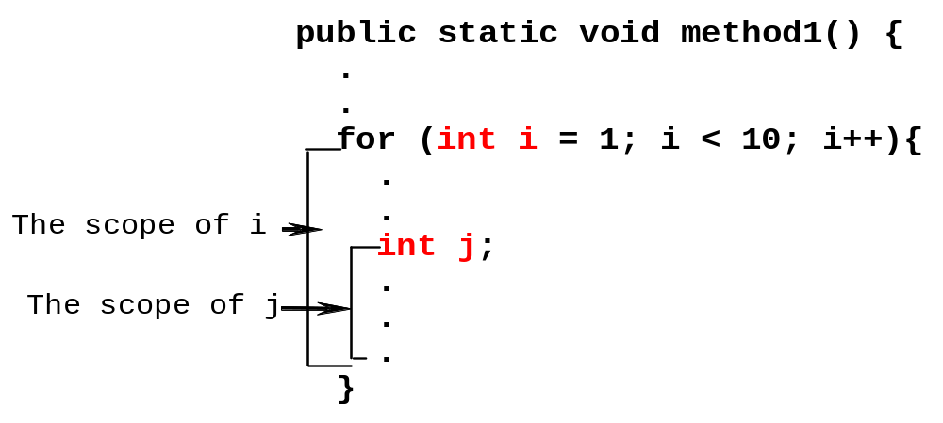
Scope of Local Variables
A variable declared in the initial action part of a for loop header has its scope in the entire loop. But a variable declared inside a for loop body has its scope limited in the loop body from its declaration and to the end of the block that contains the variable.

Slide 26
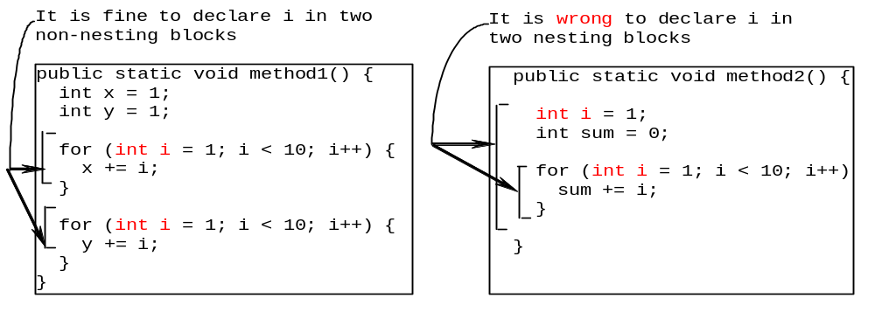
Scope of Local Variables
You can declare a local variable with the same name multiple times in different non-nesting blocks in a method, but you cannot declare a local variable twice in nested blocks.

Slide 27
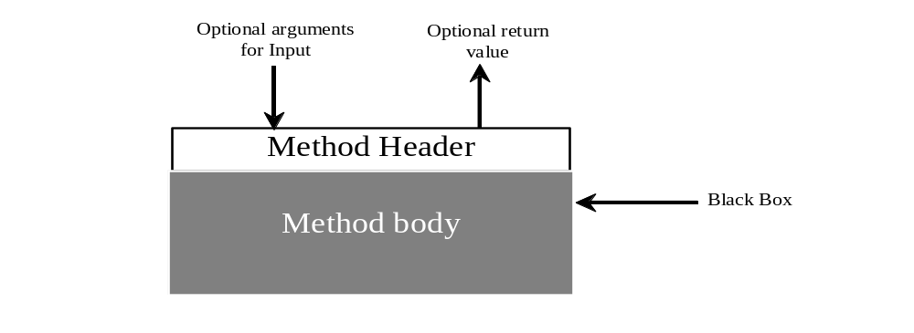

6. Method Abstraction
You can think of the method body as a black box that contains the detailed implementation for the method.
The detail implementation are hidden.
Notes:
The key to developing software is to apply the concept of abstraction.
There are different levels of abstraction.
Method Abstraction
achieved by separating the use of a method from its implementation.
the client can use a method without knowing how it is implemented.
details of the implementation are encapsulated in the method and hidden from the client who invokes the method.
if you change the implementation of the method, the client program will not be affected, providing the method header is not changed.
e.g. we’ve used the System.out.print method and JOptionPane.showInputDialog method without knowing the implementation details.

Slide 28
Benefits of Methods
Write a method once and reuse it anywhere.
Information hiding. Hide the implementation from the user.
Reduce complexity.
Ease of maintenance
Notes:
Ease of maintanence

Slide 29
7. The Math Class
The Math class contains mathematical constants and methods which perform basic mathematical functions.
Class constants:
  PI
  E
Class methods:
  Trigonometric Methods
  Exponent Methods
  Rounding Methods
  min, max, abs, and random Methods

Slide 30
Trigonometric Methods
Examples:
Math.sin(0) returns 0.0
Math.sin(Math.PI / 6) returns 0.5
Math.sin(Math.PI / 2) returns 1.0
Math.cos(0) returns 1.0
Math.cos(Math.PI / 6) returns 0.866
Math.cos(Math.PI / 2) returns 0
Math.cos(Math.toRadians(270)) returns -1.0
sin(double a)
cos(double a)
tan(double a)
acos(double a)
asin(double a)
atan(double a)
Radians
Notes:
1 degree = PI / 180 radians
toRadians (double angleInDegree) – converts an angle in degrees to radians
toDegrees (double angleInRadians) – converts an angle in radians to degrees

Slide 31
pow, sqrt Methods
pow(double a, double b)
  Returns a raised to the power of b.
sqrt(double a)
  Returns the square root of a.
Examples:
Math.pow(2, 3) returns 8.0
Math.pow(3, 2) returns 9.0
Math.pow(3.5, 2.5) returns 22.91765
Math.sqrt(4) returns 2.0
Math.sqrt(10.5) returns 3.24

Slide 32
min and max Method
max(a, b)
min(a, b)
  Returns the maximum or minimum of two parameters.
Examples:
Math.max(2, 3) returns 3
Math.max(2.5, 3) returns 3.0
Math.min(2.5, 3.6) returns 2.5

Slide 33
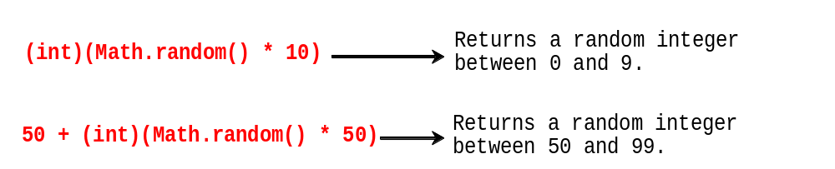
The random Method
Generates a random double value greater than or equal to 0.0 and less than 1.0 (0 <= Math.random() < 1.0).
Examples:
(char)(‘A’ + Math.random() * (‘F’ – ‘A’ + 1)); Return a random character
between A and F
In general,

Slide 34
For more information about the methods on Math class, please refer to Oracle Help Center at
https://docs.oracle.com/javase/10/docs/api/java/lang/Math.html

Slide 35
Generate random character
public class RandomCharacter {
/** Generate a random character between ch1 and ch2 */
public static char getRandomCharacter(char ch1, char ch2) {
return (char)(ch1 + Math.random() * (ch2 - ch1 + 1));
}
/** Generate a random lowercase letter */
public static char getRandomLowerCaseLetter() {
return getRandomCharacter ('a', 'z');
}
/** Generate a random digit character */
public static char getRandomDigitCharacter() {
return getRandomCharacter ('0', '9');
}
}
RandomCharacter
TestRandomCharacter

Slide 36
8. Exception Handling
  Exception : An error that occurs at run time.
import java.util.Scanner;
public class ExceptionDemo {
public static void main(String[] args) {
Scanner scanner = new Scanner(System.in);
System.out.print("Enter an integer: ");
int number = scanner.nextInt();
System.out.println("The number entered is " + number);
}
}
ExceptionDemo.java
Read integer
Question : What will happen when input other than integer ?

Slide 37
Exception Handling
Streamlines error handling by allowing your program to define a block of code called an exception handler.
The exception handler is automatically executed when an error occurs.
In Java, exception handling is managed using 5 keywords: try, catch, throws, throw and finally.
[Note: we will only cover try and catch.]

Slide 38
Using try and catch
Steps:
Put the code that you want to monitor for errors within a try block.
When an exception occurs, the exception is thrown out of the try block and caught by the catch statement. At this point, control passes to the catch, and the try block is terminated.
After the catch statement executes, program control continues with the statement following the catch. Thus, it is the job of the exception handler to remedy the problem that caused the exception.

Slide 39
public class HandleExceptionDemo {
public static void main(String[] args) {
Scanner scanner = new Scanner(System.in);
boolean continueInput = true;
do {
try {
System.out.print("\nEnter an integer: ");
int number = scanner.nextInt();
System.out.println("\nThe number entered is " + number);
continueInput = false;
}
catch (Exception ex) {
System.out.println("Incorrect input: an integer is required");
scanner.nextLine();
}
} while (continueInput);
}
}
Enhanced version
HandleExceptionDemo.java

Slide 40
The finally Clause
Used when there are statements that are always to be executed, whether the try block exits normally or not.
try {
statements;
}
catch(TheException ex) {
handling ex;
}
finally {
finalStatements;
}

Slide 41
Review of learning outcomes
You should now be able to
Define methods, invoke methods and pass arguments to methods.
Use method overloading in programs.
Write a try-catch block to handle exceptions.

Slide 42
To Do
Review the slides and source code for this chapter.
Read up the relevant portions of the recommended text .
Complete the remaining practical questions for this chapter.
  We shall selectively discuss them during class.

